Slide 1

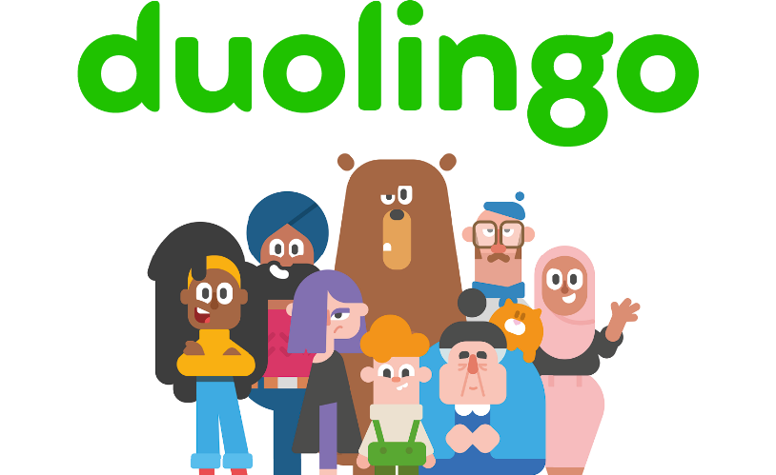

Duolingo Growth Strategy Presentation
Yashash Mathur | ClassVerse

Slide 2
AGENDA
Problem & Solution
Market Opportunity
Target Customer
Competitive Advantage
Suggested Marketing & Outreach Strategies
Monetization Plan
Future Roadmap

Slide 3
Problem and solution
Problem:
Traditional language learning methods are expensive, time-consuming, and inaccessible
1.5 billion people are learning a language worldwide, but face barriers to effective learning
Classroom instruction is limited by schedule, cost, and geography
Self-study lacks structure, feedback, and motivation
Solution:
Duolingo democratizes language education through:
Free, accessible mobile-first learning platform
Scientifically-designed curriculum using spaced repetition
Gamification to drive motivation and habit formation
AI-powered personalization adapting to individual needs
Bite-sized lessons (5-10 minutes) fitting into busy lives

Slide 4
Market Opportunity
Global Language Learning Market:
$17.3 billion market (2024), growing at 13.5% CAGR
Digital segment represents 60% and growing rapidly
Projected to reach $37 billion by 2030
Untapped Potential:
1.5 billion language learners globally
Only 8-9% conversion to paid language learning solutions
Corporate language training ($2.5B market) largely untapped by Duolingo
Emerging markets showing accelerated growth (LATAM, India, Southeast Asia)
Language certification market ($1.8B) disruption opportunity
Education technology adoption accelerated post-pandemic

Slide 5
Target Customer Segments
Casual Learners (Primary)
Age: 18-35
Professional Developers
Age: 25-45
Location: Primarily emerging markets
Educational Users
Global English Learners
Motivations: Travel, personal growth, cultural interest
Pain points: Maintaining motivation, fitting learning into busy schedule
Opportunity: Expand engagement beyond initial curiosity
Age: 13-22
Motivations: School requirements, college applications, study abroad
Pain points: Need for more formal assessment and credentialing
Opportunity: Deeper integration with educational institutions
Motivations: Economic mobility, education access
Pain points: Affordable credentialing, practical application
Opportunity: Expand English test offering and job- placement services
Motivations: Career advancement, relocation, business needs
Pain points: Lack of professional/business content
Opportunity: Create business-focused content and B2B solutions
5

Slide 6
Competitive Advantage
Duolingo's Unique Position:
Data Advantage: 500M+ registered users generating learning data
Brand Recognition: Most downloaded education app worldwide
Engagement Expertise: Industry-leading gamification and behavioral psychology
Monetization Balance: Strong free experience with compelling premium features
AI Capabilities: Advanced natural language processing and adaptive learning algorithms
Research Foundation: Science-based approach with published efficacy studies
Academic Credibility: English Test accepted by 4,000+ institutions
Platform Ecosystem: Expanding beyond language to literacy, math, and more
Competitive Moat:
Network effects from user-generated content and community
Scale economies in content development and AI training
Expertise in converting and retaining free users to subscribers (8-9% conversion)
6

Slide 7
Marketing & Outreach
Strategies
Higher Education Partnerships
Expand university acceptance of Duolingo English Test
B2B Enterprise Program
Localize app experience for high-potential markets (India, Brazil, Indonesia)
Emerging Market Expansion
Content Creator Partnerships
"Learn Together" Social Campaign
Launch friend/family referral program with shared rewards
Create viral social challenges around language milestones
Implement group learning features to increase accountability
Partner with mobile carriers for zero-rating data usage
Develop market-specific content addressing local needs
Create co-branded certificate programs with prestigious institutions
Develop campus ambassador programs at key universities
Localize app experience for high-potential markets (India, Brazil, Indonesia)
Partner with mobile carriers for zero-rating data usage
Develop market-specific content addressing local needs
Localize app experience for high-potential markets (India, Brazil, Indonesia)
Partner with mobile carriers for zero-rating data usage
Develop market-specific content addressing local needs

Slide 8
Monetization Plan
Enhanced Subscription Tiers
Super Duolingo ($7-10/month): Current premium offering
Enterprise Solutions
Team/corporate subscriptions with admin controls
Marketplace Expansion
Community tutor marketplace with revenue sharing
Expanded Certification Ecosystem
Strategic Partnerships
Duolingo Pro ($15-20/month): Advanced features for serious learners
Live tutor sessions, professional content, advanced grammar
Family Plans ($20-25/month): Up to 6 family members
Student Plans ($4-5/month): Verified student discount
Learning management system (LMS) integration
Custom content development for industries/companies
Progress tracking and reporting for HR departments
Premium content from third-party developers
Language exchange facilitation services
Cultural immersion experiences with partners
Additional proficiency tests beyond English
Professional certificate programs
Skill verification badges for professional profiles
Accredited continuing education credits
Travel industry integrations (airlines, booking sites)
Integration with professional networking platforms
Content licensing to educational publishers
White-label solutions for educational institutions

Slide 9
Future Roadmap
36-Month Expansion:
Establish Duolingo as the standard for language credentialing
24-Month Vision:
Create blended learning experience with online/offline components
12-Month Initiatives:
Launch Duolingo Pro tier with advanced learning features
Create comprehensive learning ecosystem beyond languages
Develop AI-powered personalized curriculum adaptation
Build direct pathways to employment opportunities
Establish Duolingo Centers in key global markets
Develop comprehensive professional language curriculum
Expand to 5 new emerging markets with localized experiences
Build credential ecosystem with educational/employment partners
Launch specialized content for industries (healthcare, hospitality, tech)
Release business content modules for top 5 languages
Implement AI conversation partner for speaking practice
Expand B2B platform with enterprise features
Launch two additional language proficiency tests

Slide 10
Implementation & Success Metrics
Key Performance Indicators:
Monthly Active Users (MAU): 20% YoY growth
Paid Subscription Conversion: Increase from 8-9% to 12-15%
Subscriber Retention: Improve annual retention from 65% to 75%
Revenue Diversification: Reduce core app dependence from 85% to 70%
Enterprise Customer Acquisition: 500 corporate clients in first year
New Market Penetration: Achieve 5M MAU in target emerging markets
Implementation Approach | Quarter
Research & Market Validation | Q3 2025
Product Development & Testing | Q4 2025
Pilot Programs & Refinement | Q1 2026
Full-Scale Launch & Marketing | Q2 2026

Slide 11



Thank you!

